Slide 1
DIAGNOSING AND MANAGING SEPSIS IN ED
TARIQ NEHVI
SENIOR CONSULTANT IN EMERGENCY MEDICINE
Program Lead, EMET
LYELL MCEWIN HOSPITAL

Slide 2
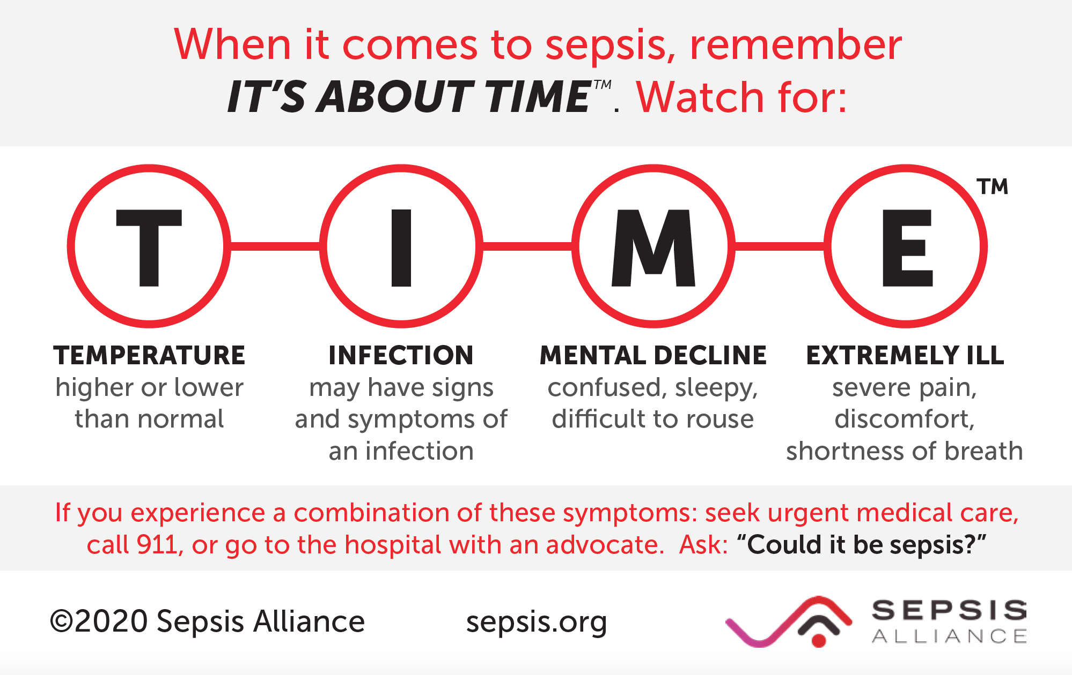

Slide 3
Why is recognizing sepsis early so important
Delayed or missed diagnosis = significant morbidity/mortality
Early treatment needs an early diagnosis (even if just suspected Dx)
Each hour Rx delayed, mortality increases by 8-10%
How do you recognize / suspect sepsis in your department?

Slide 4
65 year old male with COPD..
Productive cough 4 days, green sputum
SOBOE, worsening
Salbutamol/Seretide at home – no relief
HR 102, BP 130/90, Sats 94% RA
Speaks full sentences, clinically looks well
Right basal creps, mild wheeze, CXR shows right basal consolidation
Discharge?
Sepsis?

Slide 5
55 year old man with hypertension and prostate cancer in remission
3 days of burning pain on micturition
Fevers, rigors and chills
HR 110, RR 20, BP 130/90, Sats 98%RA, Temp 38.6 C
Alert and fully oriented
Tender suprapubic and both flanks
WBC 18000, Creatinine 140 (normal <100)
UA – WBC, nitrites
Lactate 1.2 mmol/L
Ibuprofen, paracetamol, fluid bolus and feels well…

Slide 6
70 year old woman with diabetes, HTN and colon cancer
From a local NH
Right foot and leg swelling and redness
2 days of increasing confusion
Ambulance – initial BP 85/50, HR 70, BGL 16
Unable to provide hx, screams to pain when right leg moved
Right foot and leg extremely tender, warm and erythematous
BP in ED 70/40, HR 90, sats 95
Given fluid bolus ..
Pressors vs further fluid boluses

Slide 7
SEPSIS - adult
2O Million cases per year, globally
15-40% of them die
Huge differences in outcome between developed and developing world
Controversial definitions
Even more controversial - best management guidelines

Slide 8
Simplified definitions
Third International Consensus Definitions for Sepsis and Septic Shock – Sepsis -3
SEPSIS - “life threatening organ dysfunction caused by a dysregulated host response to infection”
SEPTIC SHOCK – “sepsis with hypotension not responsive to fluid resuscitation”
  Added requirement for vasopressors to maintain MAP > 65mmHg
  Lactate > 2mmol/L
Notes:
SIRS criteria no longer recommended

Slide 9
SURVIVING SEPSIS CAMPAIGN and SEPSIS-3
Adopted the “sepsis – 3” definitions
Provided internationally accepted guidelines on Dx and Mx
Derived a bedside assessment tool for sepsis screening in non-ICU patients - qSOFA

Slide 10
SEPSIS -3 definitions
Severe sepsis – SOFA score > 2 plus suspected infection
Septic shock – Sepsis (and despite adequate volume resuscitation):
  Vasopressor requirement to maintain MAP > 65mmHg, and
  serum lactate > 2mmHg (in the absence of hypovolaemia)
Sepsis is a dynamic condition
  Clinical and lab criteria change over time!
  All criteria may not be present at a single time.

Slide 11
SIMPLIFIED ORGAN FAILURE ASSESSMENT SCORE (SOFA SCORE)
Expanded, detailed and time consuming analysis of criteria
  Respiratory (PaO2/FiO2 ratio)
  MAP and inotrope requirement to maintain MAP> 70 mmHg
  Liver (rising bilirubin level)
  Renal status (creatinine)
  Coagulation status ( degree of decrease in platelet counts)
  Neurological status (GCS)
Not practical to use in an ED environment

Slide 12
qSOFA (quick SOFA)
Bedside assessment tool
1 point for each:
  Hypotension: SBP <100
  Altered Mental State (AMS)
  Tachypnoea: RR >22
Score > 2 suggestive of sepsis.
If score <2 but clinical suspicion persists, use full SOFA including lab results

Slide 13
qSOFA
Is not perfect either
  Only retrospective validation so far
  Not demonstrated usefulness in the wide range of clinical settings that sepsis is encountered
  New onset versus established qSOFA points – unknown

Slide 14
ALL HYPOTENSION IS NOT SEPSIS!
All sepsis is not hypotension either!
We shall discuss and find out together a bit later

Slide 15
AT RISK
Extremes of age
Immunocompromised
Comorbidity (DM, CCF, Vasculopaths)
Obese
IVDUs
Chronic inflammatory diseases
Cancer/chemotherapy
Institutionalised patients
Mental illness ( for example schizophrenia)

Slide 16
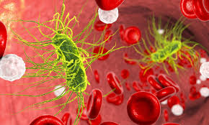

Slide 17
Why is it not recognized early enough?
Varied presentations, often subtle and atypical presentations esp in very young and very old
Confounding differentials
Lack of clear, uniform definitions
Lack of awareness/understanding
Poor education and policies/guidelines
Poor governance

Slide 18
INFECTIVE FOCUS OF SEPSIS
Respiratory (pneumonias)
Intra-abdominal infections
UTIs
Skin and soft tissue
CNS
CVS
Gram+ organisms predominate in community acquired infections
Gram –ves predominate in ICU/hospital acquired infections

Slide 19
Non-infectious conditions mimicking sepsis
Cardiovascular – dysrhythmias, Tamponade, PE, cardiogenic shock (MI), APO/CCF
Endocrine - DKA, Thyroid storm, Adrenal insufficiency
Circulatory – Hypovolaemia, Drugs (diuretics), haemorrhage, burns, dehydration
Respiratory – Massive aspiration, atelectasis
Immune – Anaphylaxis
Obstetric – haemorrhage
Toxicological – intoxications, sympathomimetic use, cholinergic crisis, alcohol withdrawal, serotonin syndrome

Slide 20
EARLY GOAL DIRECTED THERAPY (EGDT)
Was based on a landmark study by Rivers et al in 2001
Identified a 16% mortality reduction with early aggressive treatment bundle – fluids, inotropes, achieving haemodynamic goals and blood
3 recent multicenter trials failed to validate those results
EGDT no longer recommended, but early agrgressive treatment of sepsis is still recommended and does improve outcomes.

Slide 21
SPECTRUM
Ravaging, aggressive and rapidly progressive clinical course sometimes fatal within hours of onset.
Crumbling, smoldering and eventual sudden decompensation 24-72 hours later
Swift, effective management asap is vital to improving outcomes regardless of course.

Slide 22
HOW DO WE TREAT
Recognize as early as possible
Broad spectrum antibiotics
Support/Maintain perfusion of vital organs (MAP)
Source control – surgical/medical treatment
Prevent or treat complications

Slide 23
Pre-Hospital
Excellent opportunity to recognize and intervene early!
Pre-hospital judicious IV fluid bolus: Not shown to reduce mortality but does reduce hospital LOS.
Pre-hospital oxygen to hypoxic patients improves outcomes
Pre-hospital IV access saves precious time
Vital signs and airway support to AMS patients saves lives

Slide 24
Higher index of suspicion for sepsis - history
Multiple comorbidities
Recent antibiotic use/hospital admission
Recent surgery
Recent steroid use
Known immunocompromise (e.g HIV etc)
Long term residential/nursing home care
IVDUs
Allergies

Slide 25
Examination – high index of suspicion
Altered mental state +/- hypotension
Any obvious focus of infection (Head, CNS, Chest, Abdo, GIT, skin etc)
Indwelling catheters or other devices
Mottling, pallor, dusky
Fever or hypothermia
Frequent reassessment is KEY

Slide 26
Source control “as rapidly as possible”..
Missing an occult infection in a critically ill patient can have lethal consequences
Diagnostic accuracy for identifying infectious source can be as low as 60%!

Slide 27
When hypotension is present
Assess for tissue hypoperfusion including oliguria and lactate level
Evaluate cardiac output/Shock index (POCUS)
  If CoP normal or high -> distributive shock:
    If other indicators of sepsis / absence of alternative cause -> diagnose sepsis
Evaluate fluid volume status – clinical, POCUS, arterial wave-forms

Slide 28
Lactate, lactic acidosis and lactate clearance
Anaerobic glycolysis
Liver eliminates half of daily production, kidneys 30%
Accumulation → lactic acidosis
Normal range 1-1.8 mmol/L
Heart actually uses lactate for ATP production!

Slide 29
Lactic acidosis
Excess production or inadequate elimination (metabolism) of lactate
Skin and muscles, RBCs, brain, gut.
Placenta
Heavy exercise (stress) – muscles cause lactic acidosis and liver and kidneys will clear it promptly – normal levels

Slide 30
Lactic acidosis
Type A – inadequate oxygen delivery (demand-supply mismatch)
Type B – No evidence of inadequate tissue oxygen delivery
  B1 – underlying diseases (LUKES, TIPS, FAILURES)
  B2 – toxins and drugs
  B3 – inborn errors of metabolism
Notes:
LUKES - Leukaemia, lymphoma, TIPS – Thiamine deficiency, Infections, pancreatitis, short bowel syndrome, FAILURES – hepatic, renal, diabetic failure

Slide 31
Lactic acidosis in sepsis
Catecholamines
Circulatory failure
Cytopathic hypoxia – widespread microvascular shunting and mitochondrial failure
Inhibition of pyruvate dehydrogenase by bacterial toxins
Co-existent liver and kidney failure

Slide 32
Lactate levels and lactate clearance
Levels proportional to mortality
>4 → poor outcome (except in seizures, salbutamol toxicity)
Lactate clearance non-inferior to ScVO2 monitoring
Poor lactate clearance prognostically bad in trauma
Lactate is the best means to screen for “occult sepsis”.
Notes:
Occult sepsis is where patients blood pressure and mental status are good but patient is still at high risk of mortality.
Aim lactate clearance 10% at 2 hours, 20% at 4 hours, 30% at 6 hours

Slide 33
Testing – labs, imaging, bedside
Aim is
  Diagnose sepsis
  Look for organ dysfunction (Kidneys, liver)
  Identify source of infection
  Look for complications (dehydration, electrolyte imbalances etc)
  Evaluate Acid Base status
  Evidence of tissue hypoperfusion – lactate
    Lactate clearance targets
  Look for coagulopathy

Slide 34
Old resuscitation targets (EGDT targets)
CVP 8-12 mmHg
MAP > 65
Urine output >0.5ml/Kg/Hr
CVO2 (central venous oxygen saturations)

Slide 35
MANAGEMENT
INITIAL (first 3 hours)
  Lactate measure
  2 sets of IV blood cultures
    Guidelines do allow for IV Abx to be administered without cultures where cultures cannot be obtained rapidly
  IV Abx (within 1st hour)
  Isotonic fluid challenge 30ml/kg if hypotension or lactate >4 (fluid status guided)
  Other source control measures initiated e.g change indwelling catheters, arrange surgical debridement/drainage/intervention/decompression
  Trendelenburg position? Anyone uses it?

Slide 36
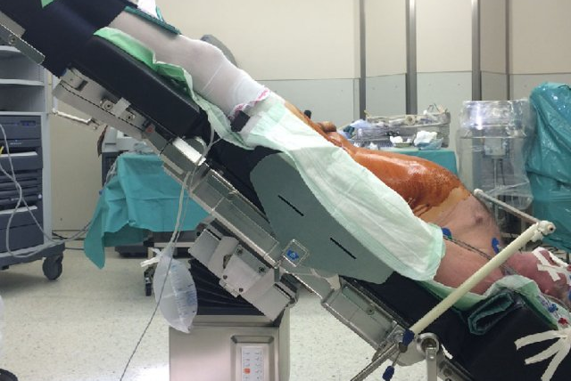

Slide 37
Surviving sepsis campaign targets
1st 3 hours
  Mearure lactate
  Obtain cultures
  Broad spectrum antibiotics
  30ml/Kg fluid for hypotension or lactate 4 mmol/L
To be completed within 6 hours of arrival
  Vasopressors to maintain MAP > 65 mmHg
  Remeasure lactate (if was elevated)
  If hypotension/hypoperfusion persists – reassess and document volume status via repeat focused exam/POCUS

Slide 38
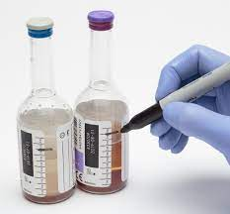

Slide 39
MANAGEMENT
FIRST 6 HOURS
  IV vasopressors – MAP >65 mmHg
  Reassess volume status and tissue perfusion
    Patient response maybe best indicator of appropriateness of further fluid volume
  Recheck lactate (only if initial was > 4)

Slide 40
FLUID MANAGEMENT
Volume
  30mls/kg and reassess, IBW vs Totat BW?
Type
  RL/plasmalyte Balanced crystalloids) vs NS (SALT ED and SMART trials) – BC favoured over NS (ICU populations)
Fluid status assessment
  Limited ECHO and IVC assessment by POCUS
  Passive leg raise test (needs CO monitor or art line)
  Arterial wave forms and pulse pressure

Slide 41
ANTIBIOTICS
Timing
  Within 1st hour (mortality increase 8% for every hour of delay)
  Benefit greatest with sepsis + hypotension
Coverage
  Guided by anatomic site of infection
  Local bacterial resistance patterns esp MRSA and ESBL
  Presence of immunosuppression/neutropaenia (HIV, splenectomy etc)
  Age and comorbidities (DM, CKD, indwelling devices etc)
  Multi-drug combos
  eTG – anti-biotics – excellent resource for choice of antibiotics

Slide 42
VASOPRESSORS
Noradrenaline recommended (available, effective, wide dosing range)
Ideally through CVC but maybe initiated via large peripheral line (eg cubital vein) – needs strict adherence to guideline/protocol. Can continue peripheral infusion for upto 3-6 hours if needed.
Invasive monitoring should be started if vasopressors commenced.
Familiarise yourself with noradrenaline (or adrenaline infusion delivery protocol)

Slide 43
PUSH DOSE PRESSOR (Adrenaline)
Sometimes a desperate need while infusions are being drawn up
Crashing BP and haemodynamics – regardless of aetiology of shock
9ml of normal saline + 1ml of 1:10,000 adrenaline (from the cardiac arrest trolley) -> 10mcg/ml of adrenaline
Use 0.5 to 2mls every 2-5 minutes (5-20 micrograms)

Slide 44
Possible emergency source control warranted
Device removal (infected vascular access, catheters, infected implants, mesh etc)
Drainage/decompression (abscess, cholangitis, obstructed pyelonephritis, septic arthritis, empyema, peritonitis)
Debridement (complicated soft tissue infection, bowel infarction, mediastinitis, peritonitis)

Slide 45
Common pitfalls
“I thought my patient would be appropriate for a ward admission..”
“I didn’t perform a complete evaluation to identify an occult source of infection prior to admission”
I was hesitant to give initial 30ml/kg bolus of fluids to my hypotensive patient..”
“I didn’t recheck lactate..”
I didn’t give noradrenaline/adrenaline as patient didn’t have a central line”
“I did not commence vasopressors in my severely hypotensive patient as I had not given enough fluid boluses yet..”

Slide 46
NECROTISING FASCITIS
High mortality!
Rapid deterioration with no obvious identifiable cause of sepsis
Pain out-of proportion (POOP)
Urgent debridement (medical management alone is not going to work)

Slide 47
Other considerations for POOP
Compartment syndrome (including orbital)
Malignant otitis externa
Mesenteric ischaemia
Aortic dissection
AAA
Acute arterial occusion
Ludwig’s angina

Slide 48
Neutropenic sepsis
Single temp >38.5C or sustained temp >38 C for one hours
Decreased absolute neutrophil count <0.5 x 10 9/L (or a predicted nadir over next 48 hours)
May not have a fever (esp. elderly, on steroids etc)
Infective organisms of concern
  Gram negative bacilli
  Coagulase negative Staphylococci
  Staph. aureus
  S. viridans
  Pseudomonas (always cover this empirically)
  Fungal (uncommon)

Slide 49
After addressing life-threats (e.g. shock)
IV antibiotics (after obtaining blood culture sets if possible)
  Piperacillin – Tazobactam (4.5gm IV 6 hourly) OR
  Ceftazidime 2gm IV 8 hourly, PLUS
  Gentamicin IV 5-7mg/kg daily
  Add vancomycin if known or suspected MRSA or has an indwelling catheter with evidence of infected catheter
  Change to Meropenem if suspected ESBL infection or clinical suspicion of necrotizing fascitits
Notes:
If septic shock – IV ABX within 30 mins, otherwise always within 1 hour.

Slide 50
Neutropaenic sepsis
Don’t forget to look for surgical source control – esp abscesses, skin and soft tissue infections or intra-peritoneal infections
BUT DO NOT PERFORM A RECTAL EXAM
These patients are often on steroids!
  Consider stress dose steroids

Slide 51
CHOLANGITIS
Rapid deterioration
“Charcot’s triad and Reynold’s pentad”
Infected obstructed biliary system “regurgitates” infected bile into blood stream – rigors and fever prominent
Medical management unlikely to work without biliary decompression
Tazobactam or Augmentin best.
Community acquired MRSA cholangitis is extremely uncommon - empiric vancomycin not generally indicated (unless culture results available)

Slide 52
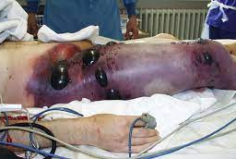

Slide 53
Paediatric and neonatal sepsis
Most infants and children with fever do not have sepsis
But a higher number of neonates with fever may have sepsis
Early recognition and treatment initiation is vital
Hypotension is a late sign in neonates and children
Delayed cap refill!!!
Be wary of a listless, irritable, lethargic neonate/infant
  Not herself, fussy, hardly feeding and mostly sleeping, vomiting a lot
  Not wetting nappies, difficult to keep awake today, hardly crying…

Slide 54


Slide 55


Slide 56
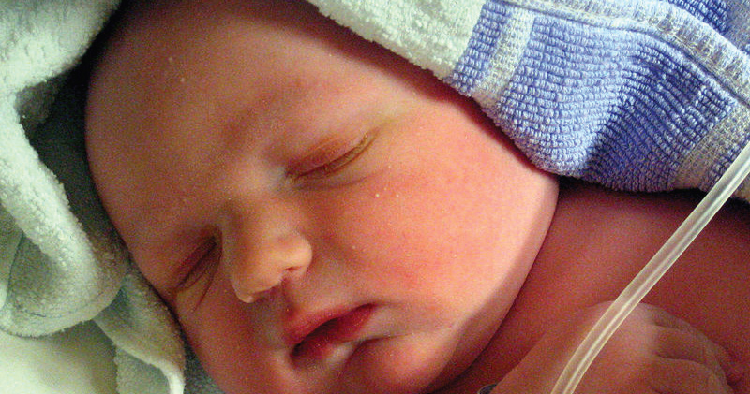

Slide 57
High risk groups ..
Neonates
Immunocompromised
CV devices, shunts
ATSI
Congenital diseases
Prems

Slide 58
Major pathogens are different in < 2 year olds
E. Coli
Group B streps
Litseria monocytogenes
HSV always considered in DDX.

Slide 59
Major pathogens in older children (>1 year)
Neisseria meningitidis
Strep. Pneumoniae
Staph. aureus
Group A sterps (GAS)

Slide 60
Red flags
HIGH DEGREE OF PARENTAL CONCERN
Re-presentation within 24 hours
Clinical deterioration despite treatment
Recent surgery or burns

Slide 61
Emergent treatment
Rapid vascular access (IO!)
Oxygen if required
Early empiric antibiotics
Seel expert help early
Carefully tirated fluid boluses
Inotropes and vasopressors can be safely initiated peripherally during initial resuscitation
Frequent re-assessment

Slide 62
Neonates
Blood, urine and CSF MCS are essential
Normal saline is fluid bolus of choice – 10ml/kg
Repeat 10ml/Kg after reassessment

Slide 63
Adrenaline infusion set up
Adrenaline infusion 0.05 – 0.2 mcg/kg/min – can use peripherally in a well placed and secured cannula (OR IO via fluid pump)
6mg Adrenaline ( 6 ampoules of 1:1000) in 1 L of normal saline
1ml/kg/hr = 0.1 mcg/kg/ml
Starting dose is 0.5ml/kg/hr (0.05mcg/kg/hr) and titrate by 0.5ml/kg/kr
Do not exceed 10ml/kg/hr (1mcg/kg/hr)

Slide 64
Antibiotics guide
< 7 days
  BenzylPenicillin 60mg/Kg + cefotaxime 50mg/kg 12 hourly
7 – 28 days
  BenzylPenicillin 60mg 6-8 hourly + cefotaxime 50mg/kg 6-8 hourly
1 – 2 months
  BenzylPenicillin 60mg/kg IV 4-6 hourly + cefotaxime 50mg/kg 4-6 hourly
> 2 months
  Ceftriaxone 100mg/kg (max 4g) daily (or cefotaxime) + flucoxacillin 50mg/kg 6H

Slide 65
Common pitfalls..
“BP was always normal so I didn’t consider sepsis or shock…”
Sats were normal so I didn’t give oxygen….”
I waited to give a second bolus because I didn’t want to fluid overload the child..”
I didn’t give antibiotics to this child because I couldn’t find any focus of infection..”
I thought fluids and antibiotics would be enough to treat shock initially. Why would I consider hydrocortisone?”
The little girl didn’t have fever so I was not really concerned about septic shock”

Slide 66
THANK YOU
ANY ?

